Slide 1

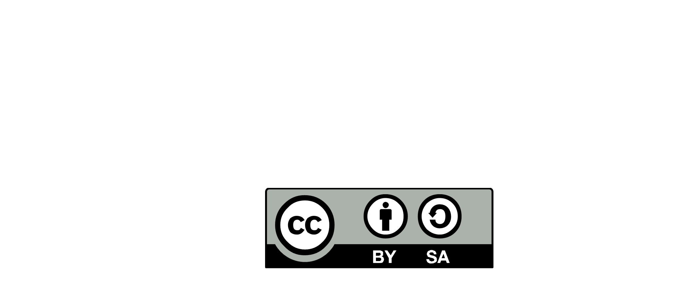


FITNESS FUNCTION
CONTINUOUS UPDATE
SPRINT
TESTING
WHY FITNESS FUNCTION ?
01
BACKLOG
BUSINESS FEATURES ANALYSIS
DEFINITION OF DONE
ARCHITECTURAL RUNWAY
REFACTORING PLAN
DEVOPS CONSTRAINTS
02
03
RUNWAY
04
05
FMEA
USES CASE
GITLAB
BACKLOG
CONSTRAINT
DECISION
LOG
NFR

Slide 2
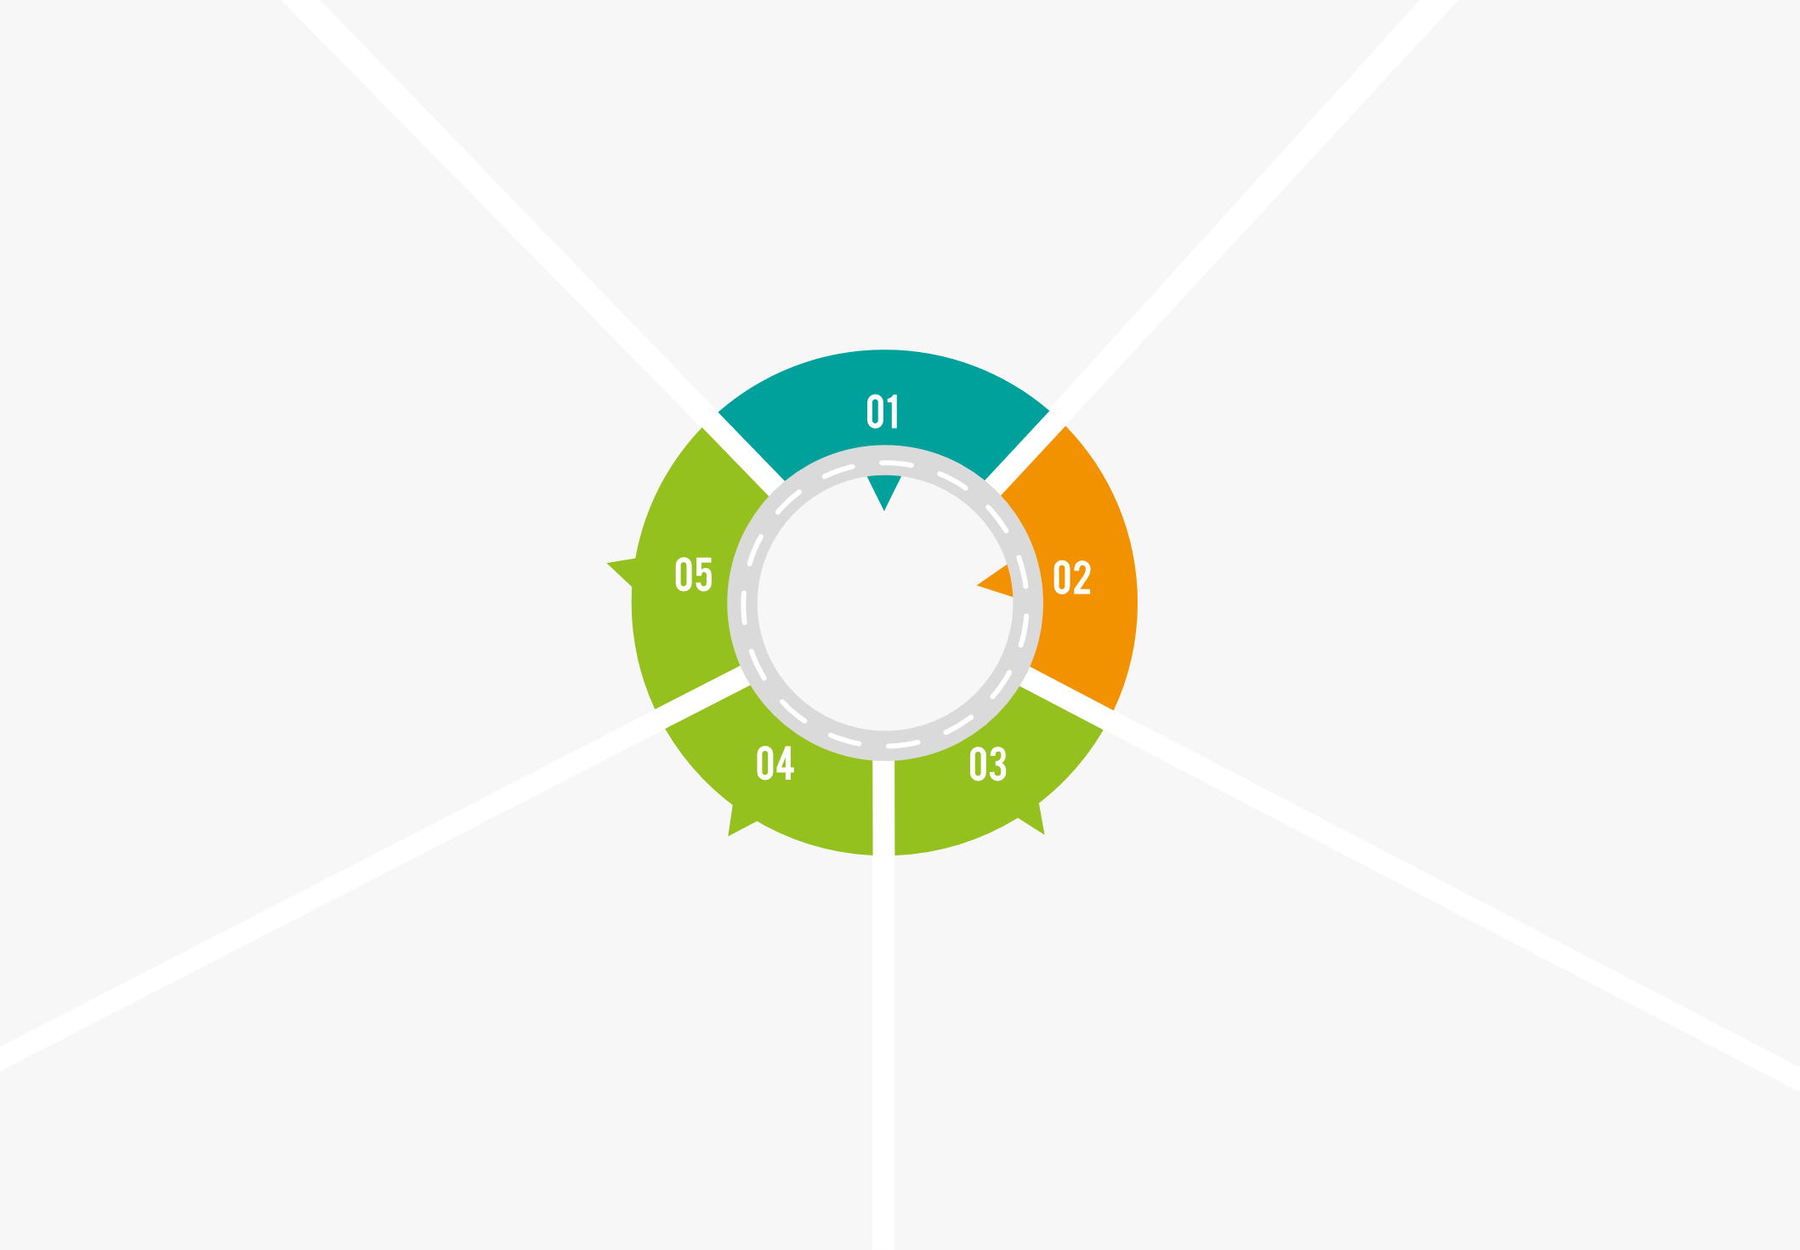

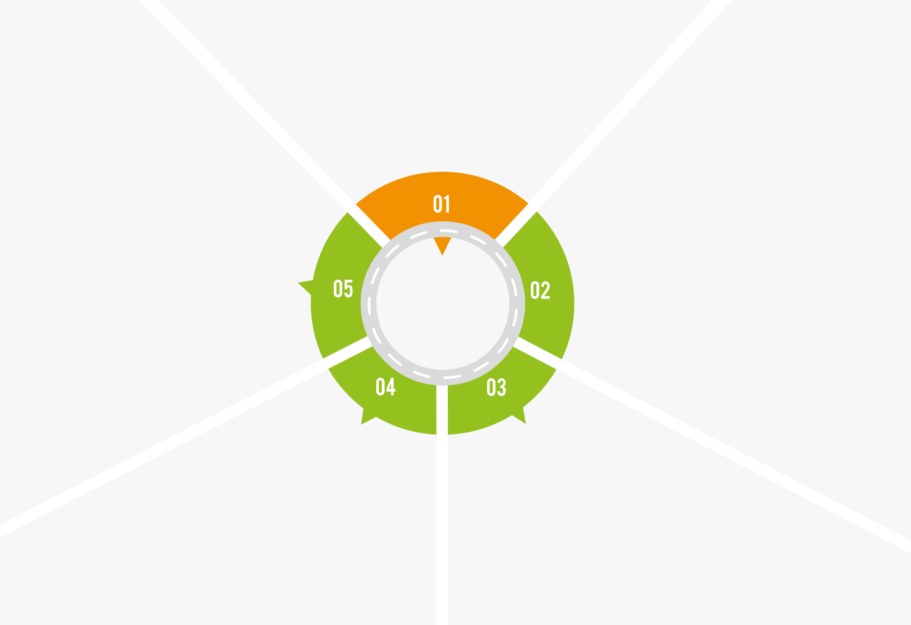
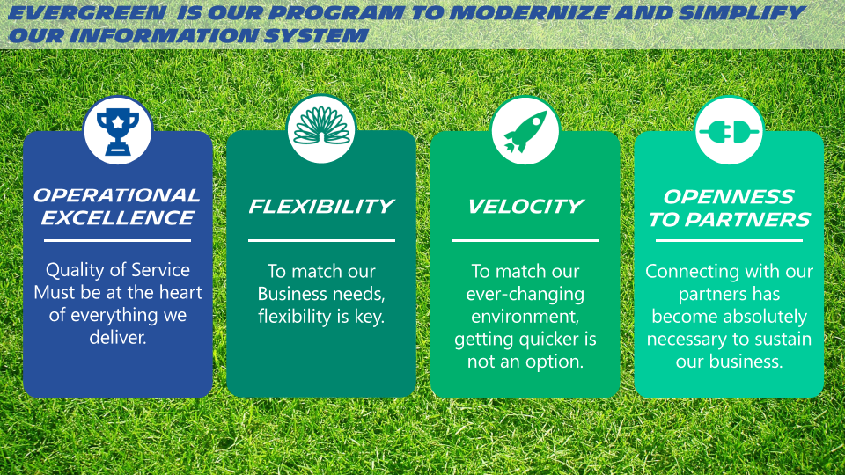

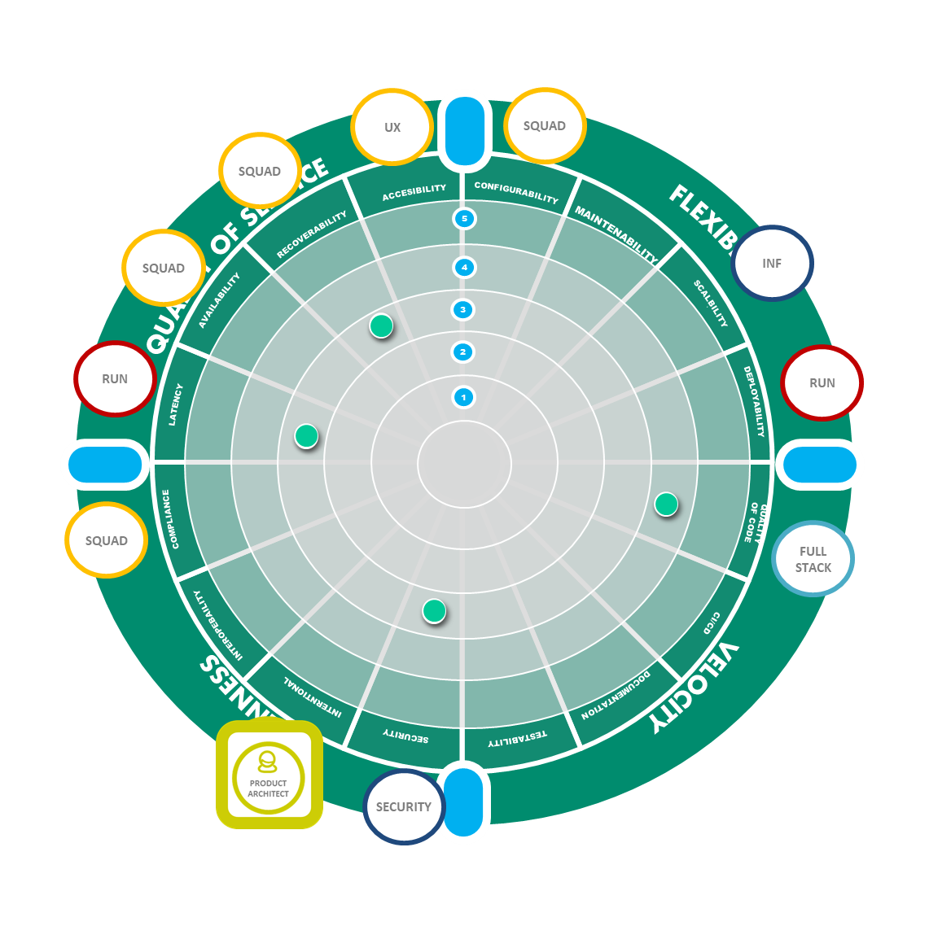
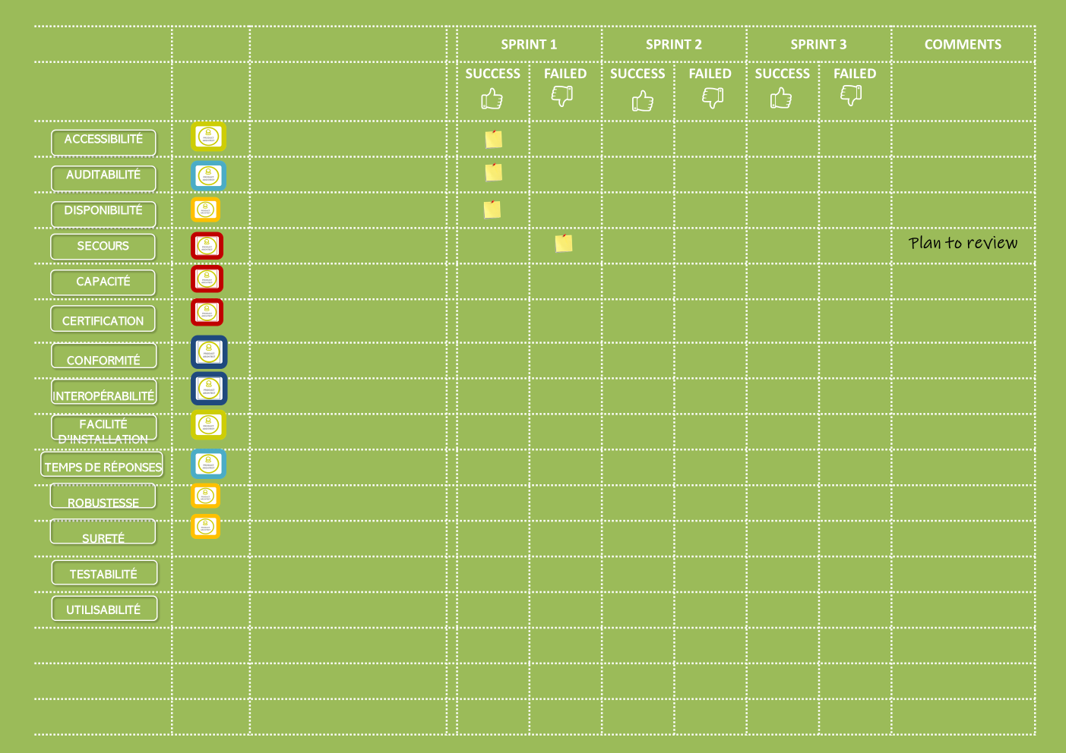

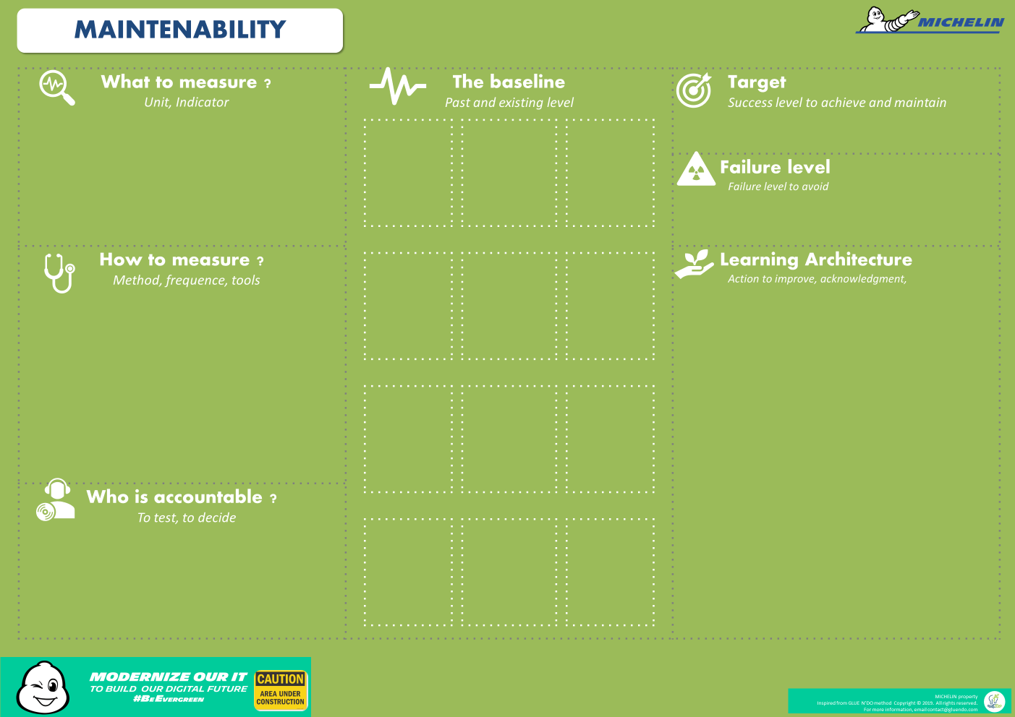
FITNESS FUNCTION
CONTINUOUS UPDATE
SPRINT
TESTING
01 – ARCHITECTURE STAKES
ARCHITECTURE STAKE
Evaluate collectively the architecture stakes
SEE THE WHOLE
Select the NFR that will matter for the product
Organise sprint testing
Manage alert and failure
Manage improvements
CONTINUOUS TESTING BOARD
02 – FOCUS
05 –IMPLEMENT
NON FUNCTIONAL REQUIREMENT GRID
FULL STACK
TEAM
LEADER
DEV.
DELIVERY
SQUAD(s)
Architect tips :
Evaluate the proposition with a costly/important matrix
Free thinking : no anticipation of measurement or testing issues
Focus on what will be measurable
TECH
LEAD
For the selected NFRs, define :
Vho is accountable of the result
Who is accountable of the measure
For the selected NFRs:
What to mesure (unit, KPI)
How to mesure (method)
The baseline
The target
The failure level
FITNESS FUNCTION CARTD
FITNESS FUNCTION CARD
Architect tips :
Evaluate the impact on product value and product development
04 – EMPOWER
03 – DEFINE

